Slide 1

PHONE BOOK DIRECTORY
BL.EN.U4AIE21015 - B. Sai Abhishek
BL.EN.U4AIE21017 - B. Ruchith Balaji
BL.EN.U4AIE21038 - Chillakuru Hari
For the subject
21AIE111- Data Structures and Algorithms -1

Slide 2
CONTENTS
Abstract
Literature Survey
Main Objective
Singly LinkedList
Detailed Description of the CODE
Implementation
Conclusion

Slide 3
ABSTRACT
People information can be tracked using the phonebook application.
Phonebook provides a set of basic functions for adding, searching, updating, and deleting new contacts. In the phonebook, you can add text, find, edit, search, and delete.
Almost all functions in this project use the concept of data structure. Functions and data structures are used.
Using this application, you can add, view, modify, receive, and delete data from/to files.
An important function of the phonebook application is the ability to add new entries, browse them, edit and update them, search for saved contacts, and delete them.

Slide 4
Main Objective
You will always have access to your contacts, whether you are at work or at home.
The basic goal of a phonebook application is to locate a person’s or organization’s address in a short amount of time.
For example, we can look up a person using their name , email, phone number.
This system can be used by the schools, bus company, government agencies, office, and company that can monitor daily activities.

Slide 5
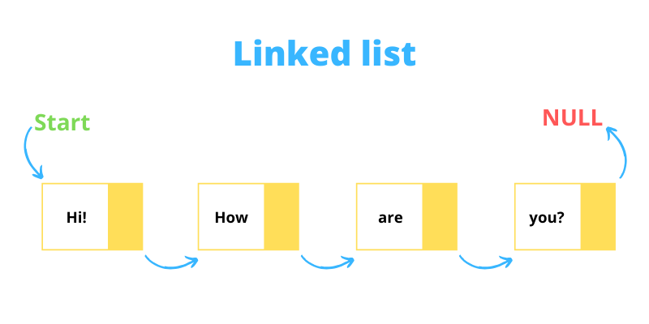
Linked-List
A Linked List is a linear data structure consisting of a collection of Nodes that are not stored in contiguous but random memory locations.
A Linked List has the following features:
Data field
Link/Pointer field
There are three common types of Linked Lists:
Singly Linked List (Using for this project)
Doubly Linked List
Circular Linked List

Slide 6

Singly Linked-List
A Singly Linked List is the most common form of a Linked List where each node contains a data field and a single pointer to the next node in the list.
The reference to the first node in the list is called the HEAD of the list.
The pointer/reference/link field contained in the node is used to traverse to the next node

Slide 7
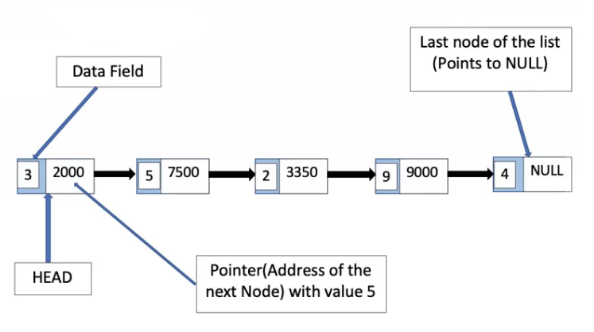
Singly Linked-List
Also, a singly linked list can only be traversed in one and only one direction i.e. from head to the last node.
There is no way to traverse from the last node back to the head. The following is an example of a singly linked list with 5 nodes.

Slide 8
ADVANTAGES of Singly LinkedList
Memory allocation
Time
DISADVANTAGES of Singly LinkedList
Traversing
Space

Slide 9
Implementation:
Create a class Node which has two attributes: data and next. Next is a pointer to the next node.
Create another class which has two attributes: head and tail.
CODE:

Slide 10
Block diagram:
Phone book
Directory
Create
Data base()
Delete Contact()
Name search()
Display all
Contacts()
Delete
Contact
Displays all
Contacts
Add Contact()
Email Search()
Recover Data()
Quit()
Recovers data from Database
Quits
Phone Book
NAME
Email
Ph.No
Searches Ph .No
By Email and Name
Creates
Contact

Slide 11
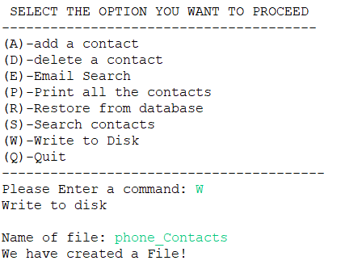
Implementation:
METHODS USED :
Create a DATA BASE to store the Contacts
After implementing the code, It asks for select a Option to proceed. If we select Write to Disk option it asks for Name of File and creates a File with Name which we have entered. All the contacts added are stored in the Database File.

Slide 12
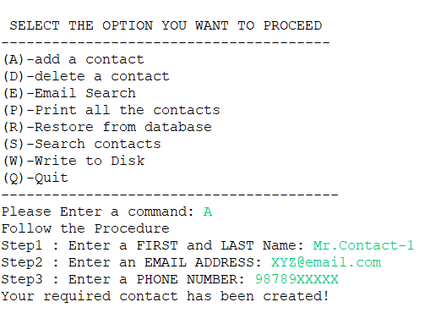
Implementation:
METHODS USED :
Adding Contact to the Phonebook
After implementing the code, It asks for select a Option to proceed. If we select Add Contact option it asks for Name , Email, and Phone Number

Slide 13
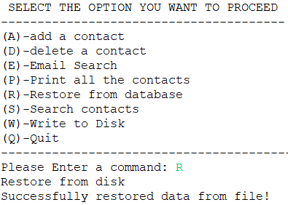
Implementation:
METHODS USED :
Restore Contacts from the Data Base
We can Restore the contacts that we have created previously are stored in Database file. By Choosing the option we can restore the data

Slide 14
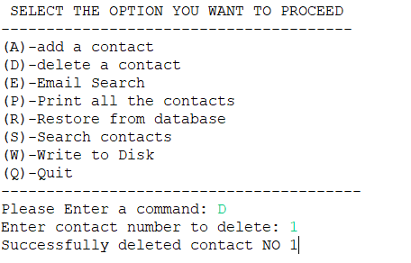
Implementation:
METHODS USED :
Deleting Contact from the Phonebook
After implementing the code, It asks for select a Option to proceed. If we select Delete Contact option it asks for Contact number.
If the Phone book is empty, It shows the BOOK IS EMPTY.
If not, it Deletes the Contact with number that we give

Slide 15
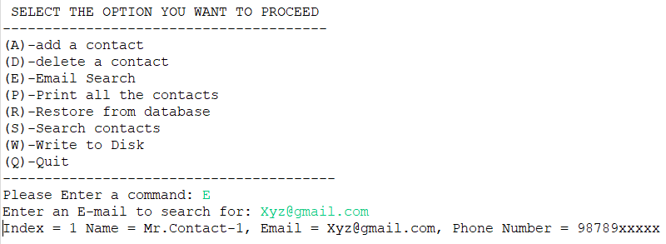
Implementation:
METHODS USED :
Search Contact in the Phonebook with Email
After implementing the code, It asks for select a Option to proceed. If we select Email search option it asks for Email to enter and then it shows the Phone number corresponding to that Email

Slide 16
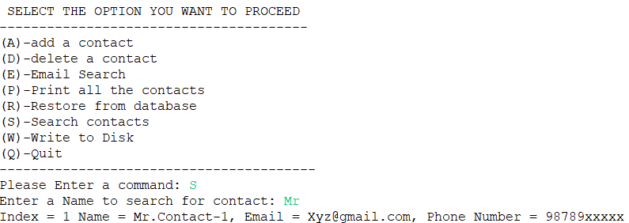
Implementation:
METHODS USED :
Search Contact in the Phonebook with Name
After implementing the code, It asks for select a Option to proceed. If we select Search Contact option it asks for Name to enter and then it shows the Phone number corresponding to that Name.

Slide 17
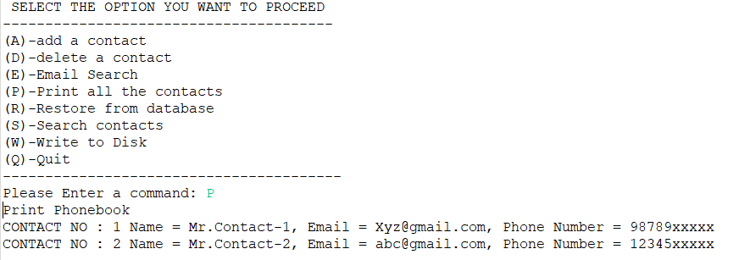
Implementation:
METHODS USED :
Displaying all the Contacts
If we want to see the contacts in the Phone Book, By Clicking the corresponding key in the Menu, It displays all the contacts in the Phone book.

Slide 18
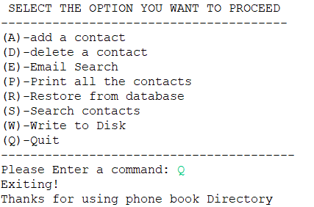
Implementation:
METHODS USED :
Exiting the Phone Book
By choosing the option Quit, the program will be quitted.

Slide 19
CONCLUSION
This Phonebook directory System Project in java with is a project created only for the purpose of meeting educational requirements.
Personal information, such as name, phone number, e-mail is requested when you add a record to your phonebook. These records can then be entered, searched, and deleted.

